Slide 1
IXIGO ✈ 🏨
FLIGHT AND HOTEL BOOKING

Slide 2
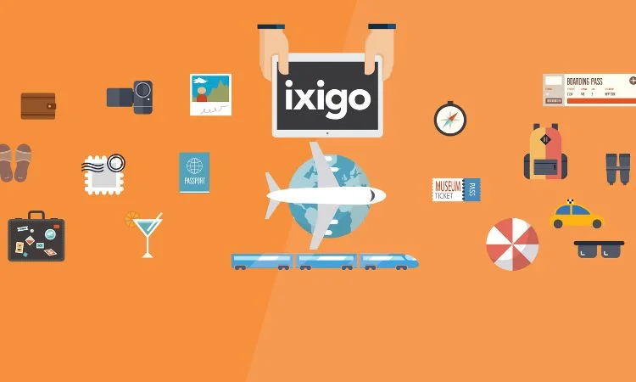

Slide 3
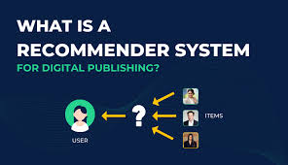
what are recommender systems ? Recommender Systems are algorithms that suggest products, services, or information to users based on their past behavior, preferences, and interests. They aim to increase user engagement, satisfaction, and conversion rates.

Slide 4
Types of recommender systems
CONTENT-BASED FILTERING
COLLABORATIVE-BASED FILTERING

Slide 5
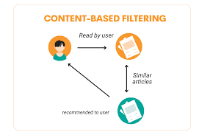
CONTENT-BASED FILTERING
Content-Based Filtering (CBF): Recommends items similar to those a user has liked or interacted with before.
Attribute-based filtering: Recommends items with similar attributes.Example: Amazon's "Frequently Bought Together" feature.
Text-based filtering: Analyzes text descriptions to recommend similar items.Example: Netflix's movie recommendations based on genres and descriptions.
Knowledge-based filtering: Uses domain knowledge to recommend items.Example: Spotify's "Discover Weekly" playlist.
Example: Amazon,Spotify

Slide 6
Here's an example of CBF on ixigo
ixigo's CBF algorithm analyzes the user's profile and recommends flights based on the following attributes:
1. Airline: IndiGo, SpiceJet
2. Flight Type: Economy
3. Departure Time: Morning
4. Travel Dates: Weekends
5. Destination: Mumbai
6. Origin: Delhi

Slide 7
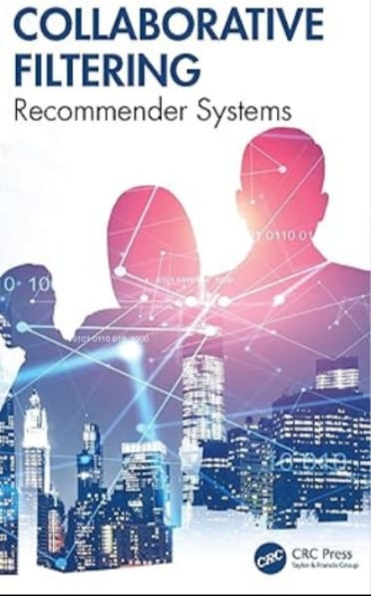
COLLABORATIVE-BASED FILTERING
Collaborative Filtering (CF): Recommends items based on the behavior of similar users
Collaborative Filtering (CF) Techniques:
User-based collaborative filtering: Recommends items liked by similar users.Example: Amazon's "Customers Who Bought This Item Also Bought“
Item-based collaborative filtering: Recommends items similar to those a user has liked.Example: Netflix's "Because You Watched" recommendations
Matrix factorization: Reduces dimensionality to improve recommendation accuracy.Example: YouTube's video recommendations.

Slide 8
Here's an example of CF on ixigo:
ixigo's CF algorithm analyzes a persons's profile and identifies similar users:
Similar Users:
1. User A: Booked hotels in Goa, Delhi, and Mumbai; prefers 4-star, luxury hotels.
2. User B: Booked hotels in Goa, Bangalore; prefers beachfront locations.
3. User C: Booked hotels in Delhi, Mumbai; prefers hotels with Wi-Fi, pool.
Benefits:
1. Personalized recommendations
2. Increased user engagement
3. Improved booking conversion rates
4. Enhanced user experience

Slide 9
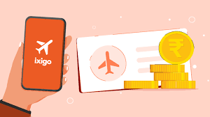
Implementing Recommender Systems on the ixigo App
Integrating recommender systems can enhance user engagement and boost conversion rates.
Benefits:
1. Personalized recommendations
2. Increased user engagement
3. Improved conversion rates
4. Enhanced user experience

Slide 10


